Slide 1
Spring – trusted and growing
Spring is fantastic for developer productivity
When asked, 67% of managers, 66% of architects, and 50% of developers strongly agreed that they care deeply about developer productivity, and Spring delivers… 95% of respondents agreed that Spring Boot has a huge positive impact on productivity, and 91% agreed that, compared to other Java development platforms, Spring has a bigger impact.
95%
91%
95% of respondents say Spring Boot has a huge positive impact on productivity
91% say Spring has a bigger impact on developer productivity than other Java programs
Spring Boot downloads per month
52%
2020
61%
2021
Nov 2018 | Nov 2019 | Nov 2020 | Nov 2021
52.5 Million+ | 95 Million+ | 152 Million+ | 239 Million+
61% of developers surveyed use Spring Boot as their only or primary development program
Source – The State of Spring 2021
Notes:
Spring is THE most popular framework / toolchain among Java developers – 61% use it as their primary or ONLY dev platform, you can see the growth
Spring Boot is obsessively developer-first, enabling Spring developers to focus on solving interesting business problems instead of writing and rewriting boilerplate code
The Spring community reflects this, with wide adoption and engagement. Kudos to all of you!!

Slide 2
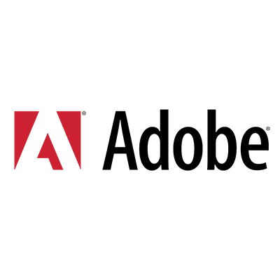

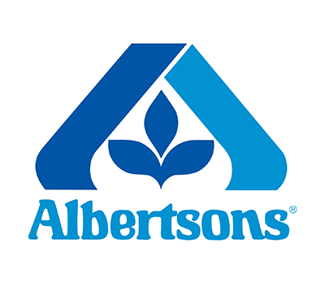



















































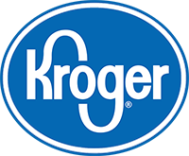





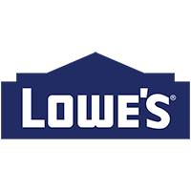



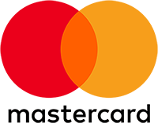

































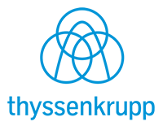



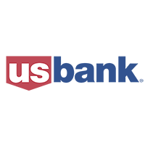

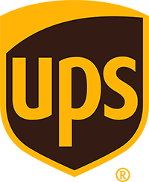






The world’s leading brands run on Azure
Notes:
Spring Boot developers deserve a cloud platform that enables them to deploy and scale with minimal effort and maximum impact
Azure and Spring work together brilliantly thanks to an ongoing collaboration between VMware and Microsoft that started in 2016. This strategic partnership began 6 1/2 years and it's going strong!
We've worked extensively on integrations, making Spring easier to run on Azure so you can focus on your apps and not the minutiae.

Slide 3


Azure Spring Apps Fully managed service for Spring Boot apps
Full integration into Azure’s ecosystem and services
Fully managed infrastructure
Built-in app lifecycle management
Ease of monitoring
Enterprise ready
Jointly built, operated and supported by Microsoft and VMware
Notes:
Azure Spring Apps is a fully managed service for Spring Boot apps that lets you focus on building and running the apps that run your business without the hassle of managing infrastructure. ​
You can simply deploy your JARs or code and Azure Spring Apps will automatically wire your apps with the Spring service runtime.
Once deployed you can easily monitor application performance, fix errors, and rapidly improve applications.​ It is integrated into Azure ecosystem and enterprise ready​.
The service is jointly developed, operated and supported by Microsoft and VMware.

Slide 4
On Kubernetes You do not have to learn or manage Kubernetes
Notes:
Azure Spring Apps is built on Kubernetes
The exciting part is, you get the power of Kubernetes, but I don't have to really worry about learning or managing it

Slide 5










Azure Spring Apps (slide 1 of 7)
Azure Spring Apps
Spring Boot apps
Service runtime
Notes:
Little more details …
The big rectangle is Azure Spring Apps, built on K8S
Each service instance has two dedicated Kubernetes clusters, they are managed by Azure Spring Apps and abstracted away from users
Service runtime with managed Spring Apps components, app lifecycle, log streaming and many more service runtime components are managed in the right side Kubernetes clluster
Your apps are running in the left cluster in the diagram
<CLICK>
Your apps can interact with any Azure service or external service or on premises systems
<CLICK>
Logs, metrics and alerts are available through Azure Monitor. You can monitor end-to-end using any tools and platform of your choice
<CLICK>
You can secure you apps using Azure Active Directory
<CLICK>
Automate end-to-end using your favorite tools and platforms
<CLICK>
You can continue to use development tools that you are familiar with – IntelliJ, VS Code, Maven, Gradle – you can deploy using tools like IntelliJ and Maven
Net-net, it is an easy way to get started, focus on your biz objectives and everything else is taken care for you in cloud
<CLICK>
Do you have to manage anything here?
No you do not have to … Azure Spring Apps has absorbed all the complexities with infrastructure, hosting microservice apps, app lifecycle, managing microservices, blue green deployments, pushing logs and metrics
All supported by Microsoft and VMware.

Slide 6












Azure Spring Apps (slide 2 of 7)
Azure Spring Apps
Spring Boot apps
Service runtime
Open source client libraries, integration modules and drivers
Data
Storage
Cache
Async communications – JMS and Kafka
Keys, secrets & certs
Notes:
Little more details …
The big rectangle is Azure Spring Apps, built on K8S
Each service instance has two dedicated Kubernetes clusters, they are managed by Azure Spring Apps and abstracted away from users
Service runtime with managed Spring Apps components, app lifecycle, log streaming and many more service runtime components are managed in the right side Kubernetes clluster
Your apps are running in the left cluster in the diagram
<CLICK>
Your apps can interact with any Azure service or external service or on premises systems
<CLICK>
Logs, metrics and alerts are available through Azure Monitor. You can monitor end-to-end using any tools and platform of your choice
<CLICK>
You can secure you apps using Azure Active Directory
<CLICK>
Automate end-to-end using your favorite tools and platforms
<CLICK>
You can continue to use development tools that you are familiar with – IntelliJ, VS Code, Maven, Gradle – you can deploy using tools like IntelliJ and Maven
Net-net, it is an easy way to get started, focus on your biz objectives and everything else is taken care for you in cloud
<CLICK>
Do you have to manage anything here?
No you do not have to … Azure Spring Apps has absorbed all the complexities with infrastructure, hosting microservice apps, app lifecycle, managing microservices, blue green deployments, pushing logs and metrics
All supported by Microsoft and VMware.

Slide 7

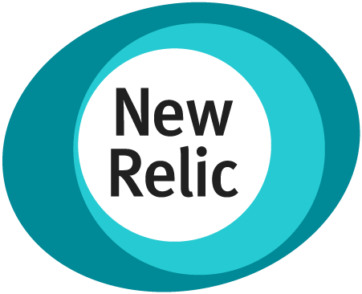



Azure Spring Apps (slide 3 of 7)
Monitor – logstream, APM & end-to-end
Azure Spring Apps
Open source client libraries, integration modules and drivers
Data
Storage
Cache
Async communications – JMS and Kafka
Keys, secrets & certs
Notes:
Little more details …
The big rectangle is Azure Spring Apps, built on K8S
Each service instance has two dedicated Kubernetes clusters, they are managed by Azure Spring Apps and abstracted away from users
Service runtime with managed Spring Apps components, app lifecycle, log streaming and many more service runtime components are managed in the right side Kubernetes clluster
Your apps are running in the left cluster in the diagram
<CLICK>
Your apps can interact with any Azure service or external service or on premises systems
<CLICK>
Logs, metrics and alerts are available through Azure Monitor. You can monitor end-to-end using any tools and platform of your choice
<CLICK>
You can secure you apps using Azure Active Directory
<CLICK>
Automate end-to-end using your favorite tools and platforms
<CLICK>
You can continue to use development tools that you are familiar with – IntelliJ, VS Code, Maven, Gradle – you can deploy using tools like IntelliJ and Maven
Net-net, it is an easy way to get started, focus on your biz objectives and everything else is taken care for you in cloud
<CLICK>
Do you have to manage anything here?
No you do not have to … Azure Spring Apps has absorbed all the complexities with infrastructure, hosting microservice apps, app lifecycle, managing microservices, blue green deployments, pushing logs and metrics
All supported by Microsoft and VMware.

Slide 8


Azure Spring Apps (slide 4 of 7)
Monitor – logstream, APM & end-to-end
Identities – end-users & machines
Azure Spring Apps
Open source client libraries, integration modules and drivers
Data
Storage
Cache
Async communications – JMS and Kafka
Keys, secrets & certs
Notes:
Little more details …
The big rectangle is Azure Spring Apps, built on K8S
Each service instance has two dedicated Kubernetes clusters, they are managed by Azure Spring Apps and abstracted away from users
Service runtime with managed Spring Apps components, app lifecycle, log streaming and many more service runtime components are managed in the right side Kubernetes clluster
Your apps are running in the left cluster in the diagram
<CLICK>
Your apps can interact with any Azure service or external service or on premises systems
<CLICK>
Logs, metrics and alerts are available through Azure Monitor. You can monitor end-to-end using any tools and platform of your choice
<CLICK>
You can secure you apps using Azure Active Directory
<CLICK>
Automate end-to-end using your favorite tools and platforms
<CLICK>
You can continue to use development tools that you are familiar with – IntelliJ, VS Code, Maven, Gradle – you can deploy using tools like IntelliJ and Maven
Net-net, it is an easy way to get started, focus on your biz objectives and everything else is taken care for you in cloud
<CLICK>
Do you have to manage anything here?
No you do not have to … Azure Spring Apps has absorbed all the complexities with infrastructure, hosting microservice apps, app lifecycle, managing microservices, blue green deployments, pushing logs and metrics
All supported by Microsoft and VMware.

Slide 9








Azure Spring Apps (slide 5 of 7)
Monitor – logstream, APM & end-to-end
Identities – end-users & machines
Automation
Azure Spring Apps
Open source client libraries, integration modules and drivers
Data
Storage
Cache
Async communications – JMS and Kafka
Keys, secrets & certs
Notes:
Little more details …
The big rectangle is Azure Spring Apps, built on K8S
Each service instance has two dedicated Kubernetes clusters, they are managed by Azure Spring Apps and abstracted away from users
Service runtime with managed Spring Apps components, app lifecycle, log streaming and many more service runtime components are managed in the right side Kubernetes clluster
Your apps are running in the left cluster in the diagram
<CLICK>
Your apps can interact with any Azure service or external service or on premises systems
<CLICK>
Logs, metrics and alerts are available through Azure Monitor. You can monitor end-to-end using any tools and platform of your choice
<CLICK>
You can secure you apps using Azure Active Directory
<CLICK>
Automate end-to-end using your favorite tools and platforms
<CLICK>
You can continue to use development tools that you are familiar with – IntelliJ, VS Code, Maven, Gradle – you can deploy using tools like IntelliJ and Maven
Net-net, it is an easy way to get started, focus on your biz objectives and everything else is taken care for you in cloud
<CLICK>
Do you have to manage anything here?
No you do not have to … Azure Spring Apps has absorbed all the complexities with infrastructure, hosting microservice apps, app lifecycle, managing microservices, blue green deployments, pushing logs and metrics
All supported by Microsoft and VMware.

Slide 10
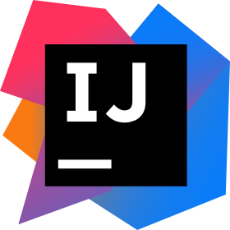

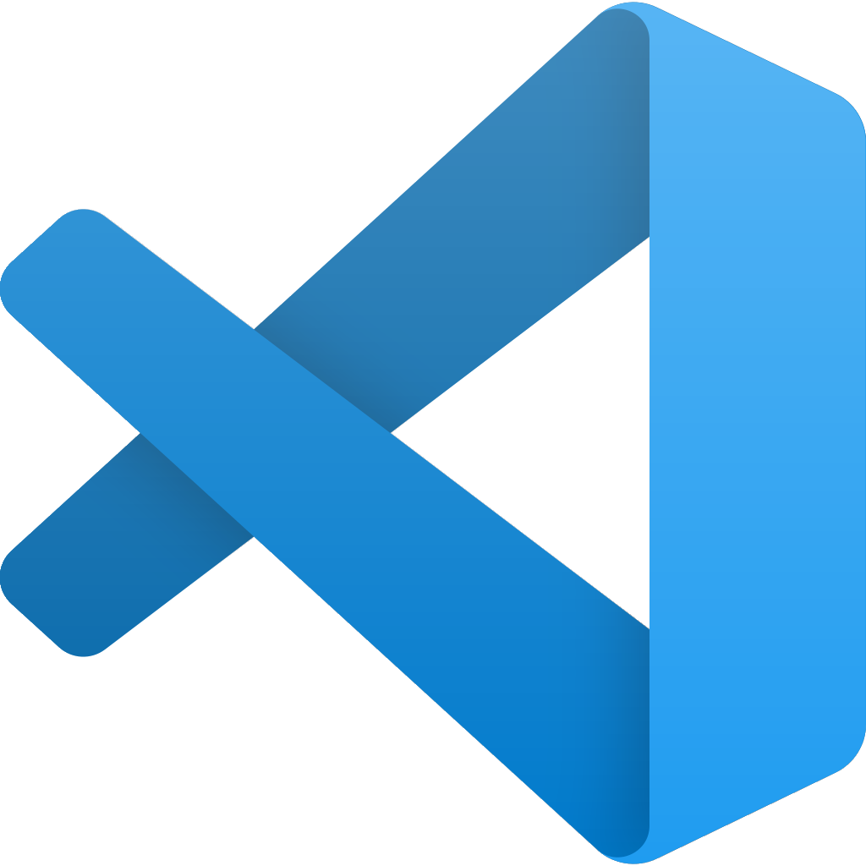
Azure Spring Apps (slide 6 of 7)
Developer experiences
Monitor – logstream, APM & end-to-end
Identities – end-users & machines
Automation
Azure Spring Apps
Open source client libraries, integration modules and drivers
Data
Storage
Cache
Async communications – JMS and Kafka
Keys, secrets & certs
Notes:
Little more details …
The big rectangle is Azure Spring Apps, built on K8S
Each service instance has two dedicated Kubernetes clusters, they are managed by Azure Spring Apps and abstracted away from users
Service runtime with managed Spring Apps components, app lifecycle, log streaming and many more service runtime components are managed in the right side Kubernetes clluster
Your apps are running in the left cluster in the diagram
<CLICK>
Your apps can interact with any Azure service or external service or on premises systems
<CLICK>
Logs, metrics and alerts are available through Azure Monitor. You can monitor end-to-end using any tools and platform of your choice
<CLICK>
You can secure you apps using Azure Active Directory
<CLICK>
Automate end-to-end using your favorite tools and platforms
<CLICK>
You can continue to use development tools that you are familiar with – IntelliJ, VS Code, Maven, Gradle – you can deploy using tools like IntelliJ and Maven
Net-net, it is an easy way to get started, focus on your biz objectives and everything else is taken care for you in cloud
<CLICK>
Do you have to manage anything here?
No you do not have to … Azure Spring Apps has absorbed all the complexities with infrastructure, hosting microservice apps, app lifecycle, managing microservices, blue green deployments, pushing logs and metrics
All supported by Microsoft and VMware.

Slide 11
Azure Spring Apps (slide 7 of 7)
Developer experiences
Monitor – logstream, APM & end-to-end
Identities – end-users & machines
Automation
Azure Spring Apps
Azure Spring Apps
Open source client libraries, integration modules and drivers
Data
Storage
Cache
Async communications – JMS and Kafka
Keys, secrets & certs
Notes:
Little more details …
The big rectangle is Azure Spring Apps, built on K8S
Each service instance has two dedicated Kubernetes clusters, they are managed by Azure Spring Apps and abstracted away from users
Service runtime with managed Spring Apps components, app lifecycle, log streaming and many more service runtime components are managed in the right side Kubernetes clluster
Your apps are running in the left cluster in the diagram
<CLICK>
Your apps can interact with any Azure service or external service or on premises systems
<CLICK>
Logs, metrics and alerts are available through Azure Monitor. You can monitor end-to-end using any tools and platform of your choice
<CLICK>
You can secure you apps using Azure Active Directory
<CLICK>
Automate end-to-end using your favorite tools and platforms
<CLICK>
You can continue to use development tools that you are familiar with – IntelliJ, VS Code, Maven, Gradle – you can deploy using tools like IntelliJ and Maven
Net-net, it is an easy way to get started, focus on your biz objectives and everything else is taken care for you in cloud
<CLICK>
Do you have to manage anything here?
No you do not have to … Azure Spring Apps has absorbed all the complexities with infrastructure, hosting microservice apps, app lifecycle, managing microservices, blue green deployments, pushing logs and metrics
All supported by Microsoft and VMware.

Slide 12
Three simple operations
Create service
1
az spring create --name ${SPRING_CLOUD_SERVICE} \ --sku standard \ --resource-group ${RESOURCE_GROUP} \ --location ${REGION}
2
Create app
az spring app create --name ${CUSTOMERS_SERVICE}
Deploy app
3
az spring app deploy --name ${CUSTOMERS_SERVICE} | --jar-path ${CUSTOMERS_SERVICE_JAR}
Notes:
Three simple steps to get started! Just 3
Azure Spring Apps is as simple to spin up as it is powerful, and it follows three simple steps:
First, create a service instance
Next, create an app within the service
And finally, deploy the application binaries or source to Azure Spring Apps.
Azure does the hard work, all you have to do is point it in the right direction. It really is that simple!

Slide 13
Spring Cloud Azure
Spring Data
SQL Database
MYSQL
PostgreSQL
Maria DB
Cosmos DB
SQL
MongoDB
Cassandra
Spring Security
Active Directory
AAD B2C
Spring Apps
App Configuration
Event Hubs
Kafka
Service Bus
Redis
Functions
Spring Integration
Service Bus
Event Hubs
Storage Queue
R2DBC
SQL Database
PostgreSQL
MySQL
Spring Messaging
Service Bus
Event Hubs
Zero Trust
Key Vault Secrets
Key Vault Certs
Spring Resource
Blog Storage
Azure Files
Spring Cache
Redis Cache
Micrometer
Monitor
aka.ms/spring-cloud-azure
Notes:
Once your apps are up and running, they can connect with Azure services
We've made it possible to leverage the full power of Azure from your Spring Boot apps, and it's getting easier to do so every day.
We provide mechanisms to connect and interact with data, messaging, cache, storage, directories and so much more.

Slide 14

Azure Spring Apps in a nutshell
Developers Easy to build and deploy
Build and scale distributed workloads at cloud scale
Externalize config, enable service registry, secure, automate end-to-end and monitoring
Harness the power of K8S without learning or operating it
Easy to spawn environments
Automate testing
Advance to production across the globe
IT Operators Easy to operate at scale
Home for distributed workloads that leverages services on Azure, on-premises and externals
Eliminate middleware management efforts – say patching, running middleware, etc.
Unlimited scale without additional hardware procurement or datacenters
Define roles and responsibilities to match your team structure – Azure RBAC (developer, DevOps, SRE, tester, security)
Govern using Azure Policy-based management and enforcement
Monitor end-to-end – detect and react faster
Automate end-to-end
Implement charge backs in line with your funding model – through Azure cost management system
Executives Peace be with you!
Minimize costs
High availability through unpredictable volumes and recover faster from failures
Expand across the globe – 60+ Azure regions with speed and scale to meet your needs
Strengthen your security posture with Azure
Supported by Microsoft and VMware
Notes:
In brief –
There is something for everyone
If you are a developer – you can build and scale workloads at cloud scale, you can easily apply cloud-friendly patterns such as externalized configuration, service registration and discovery, automating and monitoring end-to-end
You can get the full power of K8S without touching it
You can create any number of environment, automate testing and advance to production across the globe
If you are in the IT team – you can operate the service and environments at scale
The service becomes the home for distributed workloads, you can connect with services running on Azure or on-premises or anywhere
As you operate, you do not have to worry about middleware management
You get unlimited scale
You can align your team’s roles and responsibilities to match your team structure using Azure RBAC
You can apply policy management
Monitor and automate end-to-end
You can also implement charge backs in line with your funding model
If you are executive, you have the essential to minimize total cost of ownership, high availability, plenty of head room to grow the workload, you can harden your security using Azure’s security and fully supported by Microsoft and VMware

Slide 15
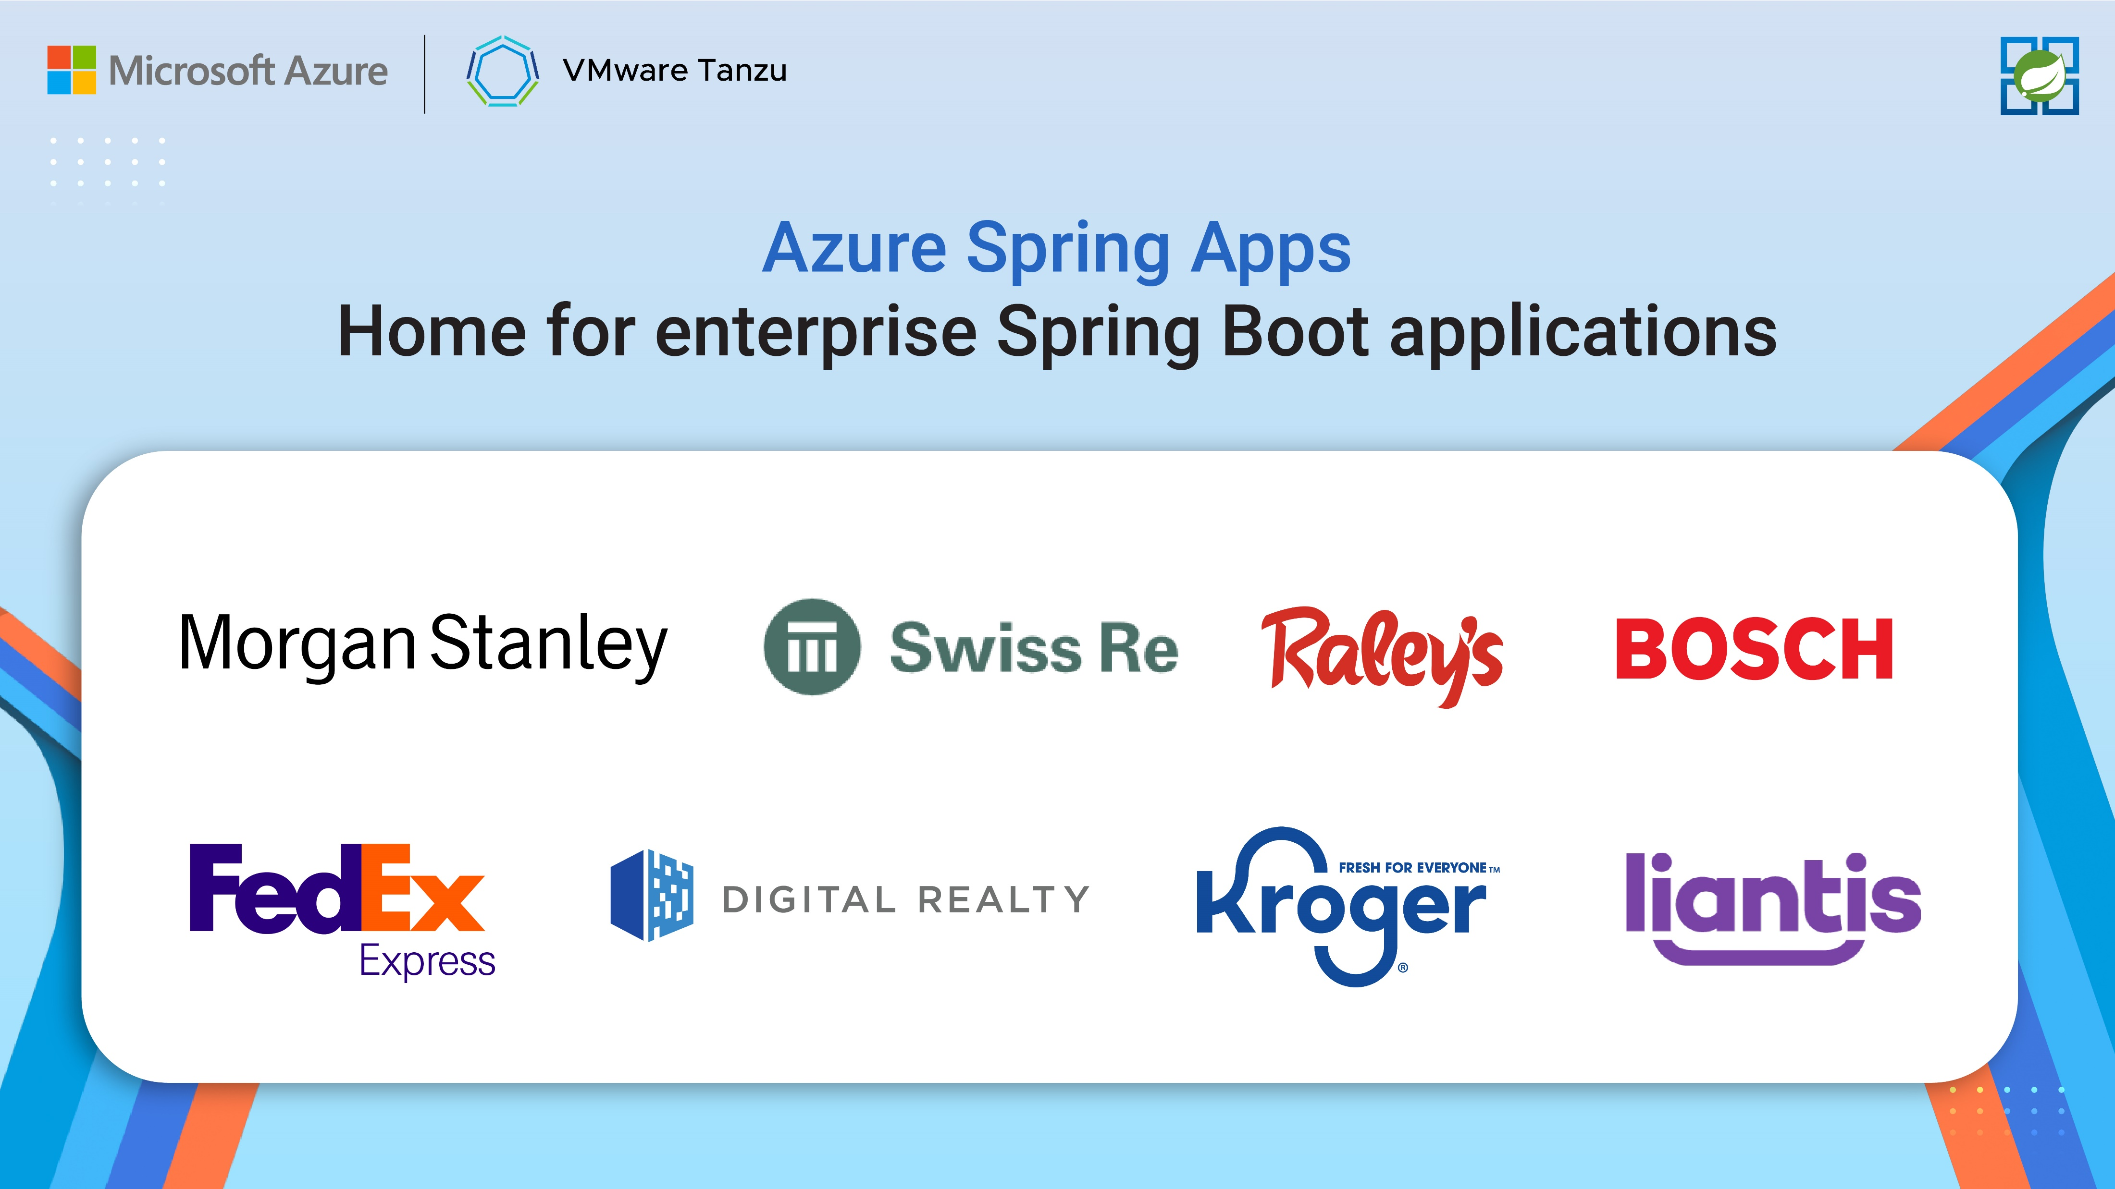

Azure Spring Apps Home for enterprise Spring Boot applications
Notes:
Enterprises are running their mission-critical Spring Boot applications at scale on Azure. <PAUSE>
With Azure Spring Apps, you get auto-scaling, app management, auto patching, ease of monitoring and many more rich platform feature

Slide 16
Azure Spring Apps Enterprise
Notes:
Now, you get more with Azure Spring Apps Enterprise

Slide 17
Azure Spring Apps Enterprise
Ship faster with VMware Tanzu components
Unlock Spring’s full potential with VMware Spring Runtime Support
Notes:
Enterprise is the new tier and is generally available
Enterprise delivers even more productivity, and you can leverage Spring experts to make your projects even more successful.

Slide 18
Ship faster with VMware Tanzu components
Build packs with app integrations
Management of app container creation
Out-of-the-box SSO with any identity provider
Out-of-the-box throttling and caching
Accelerators for hardening app config and best practices
Cloud-native streaming and batch data processing pipelines
….
Build Service
Application Configuration Service
Service Registry
Spring Apps Gateway
API portal
Application Accelerator*
Application Live View*
Spring Apps Data Flow*
….
*Roadmap is not confirmed and subject to change
Notes:
Tanzu components provide new capabilities designed for enterprises running Spring applications at scale.
Today, we will show you some of these features

Slide 19

Deploy and manage Spring and polyglot applications
Notes:
You can deploy and manage Spring applications and polyglot applications built using Node, Python, Go and .NET

Slide 20
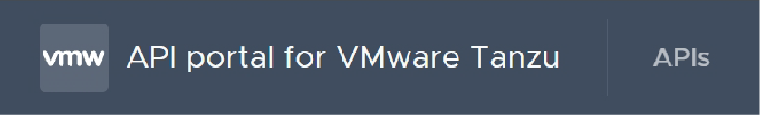

Effortlessly route client requests to apps
Notes:
With the fully managed Spring Apps Gateway, you can route any requests to apps and address cross-cutting considerations for those apps behind the gateway.
Cross cutting considerations like configuring single sign on for end users using your preferred identity provider, including Azure Active Directory or considerations like request rate limiting, and many more features like these

Slide 21
Azure Spring Apps Enterprise
Ship faster with VMware Tanzu components
Unlock Spring’s full potential with VMware Spring Runtime Support
Notes:
Let’s talk about support

Slide 22
Unlock Spring’s full potential with VMware Spring Runtime Support
AspectJ
Micrometer
Reactor
Spring AMQP
Spring Batch
Spring Boot
Spring Apps Commons
Spring Apps Config
Spring Apps Netflix
Spring Apps Bus
Spring Apps Cloud Foundry
Spring Apps Open Service Broker
Spring Apps Consul
Spring Apps Security
Spring Apps Sleuth
Spring Apps Zookeeper
Spring Apps Kubernetes
Spring Apps CLI
Spring Apps OpenFeign
Spring Apps Gateway
Spring Apps Function
Spring Apps Contract
Spring Apps Task
Spring Apps Stream
Spring Apps Stream Binder for Apache Kafka®
Spring Apps Stream Binder for RabbitMQ
Spring Apps Stream Binder for Kafka Streams
Spring Apps Vault
Spring CredHub
Spring Data for Apache Cassandra™
Spring Data Commons
Spring Data KeyValue
Spring Data LDAP
Spring Data JDBC
Spring Data JPA
Spring Data MongoDB
Spring Data GemFire
Spring Data For Apache Geode™
Spring Data Redis
Spring Data Rest
Spring Data Solr
Spring Framework
Spring HATEOAS
Spring Integration (Core Modules + Kafka)
Spring For Apache Kafka®
Spring LDAP
Spring Kerberos
Spring Rest Docs
Spring Retry
Spring Statemachine
Spring Security
Spring Security OAuth
Spring Security SAML
Spring Apps Data Flow
Spring Session
Spring Session for MongoDB
Spring Session for GemFire/ Apache Geode™
Spring Tool Suite
Spring Tools 4
Spring Vault
Spring Apps Skipper
Spring Apps Stream/ Task App Starters
Get 24/7 support
Notes:
Support and expert guidance for Spring projects let you develop and deploy applications faster.

Slide 23
Commercial support for Spring Boot
2.7x
2.6x
2022-06-29
Legend:
 | OSS support |  | Commercial support |  | Future release
 | Free security updates and bugfixes with support from the Spring community. |  | Business support from Spring experts during the OSS timeline, plus extended support after OSS End-Of-Life. Publicly available releases for critical bugfixes and security issues when requested by customers. |  | Generation not yet released, timeline is subject to changes.

Slide 24
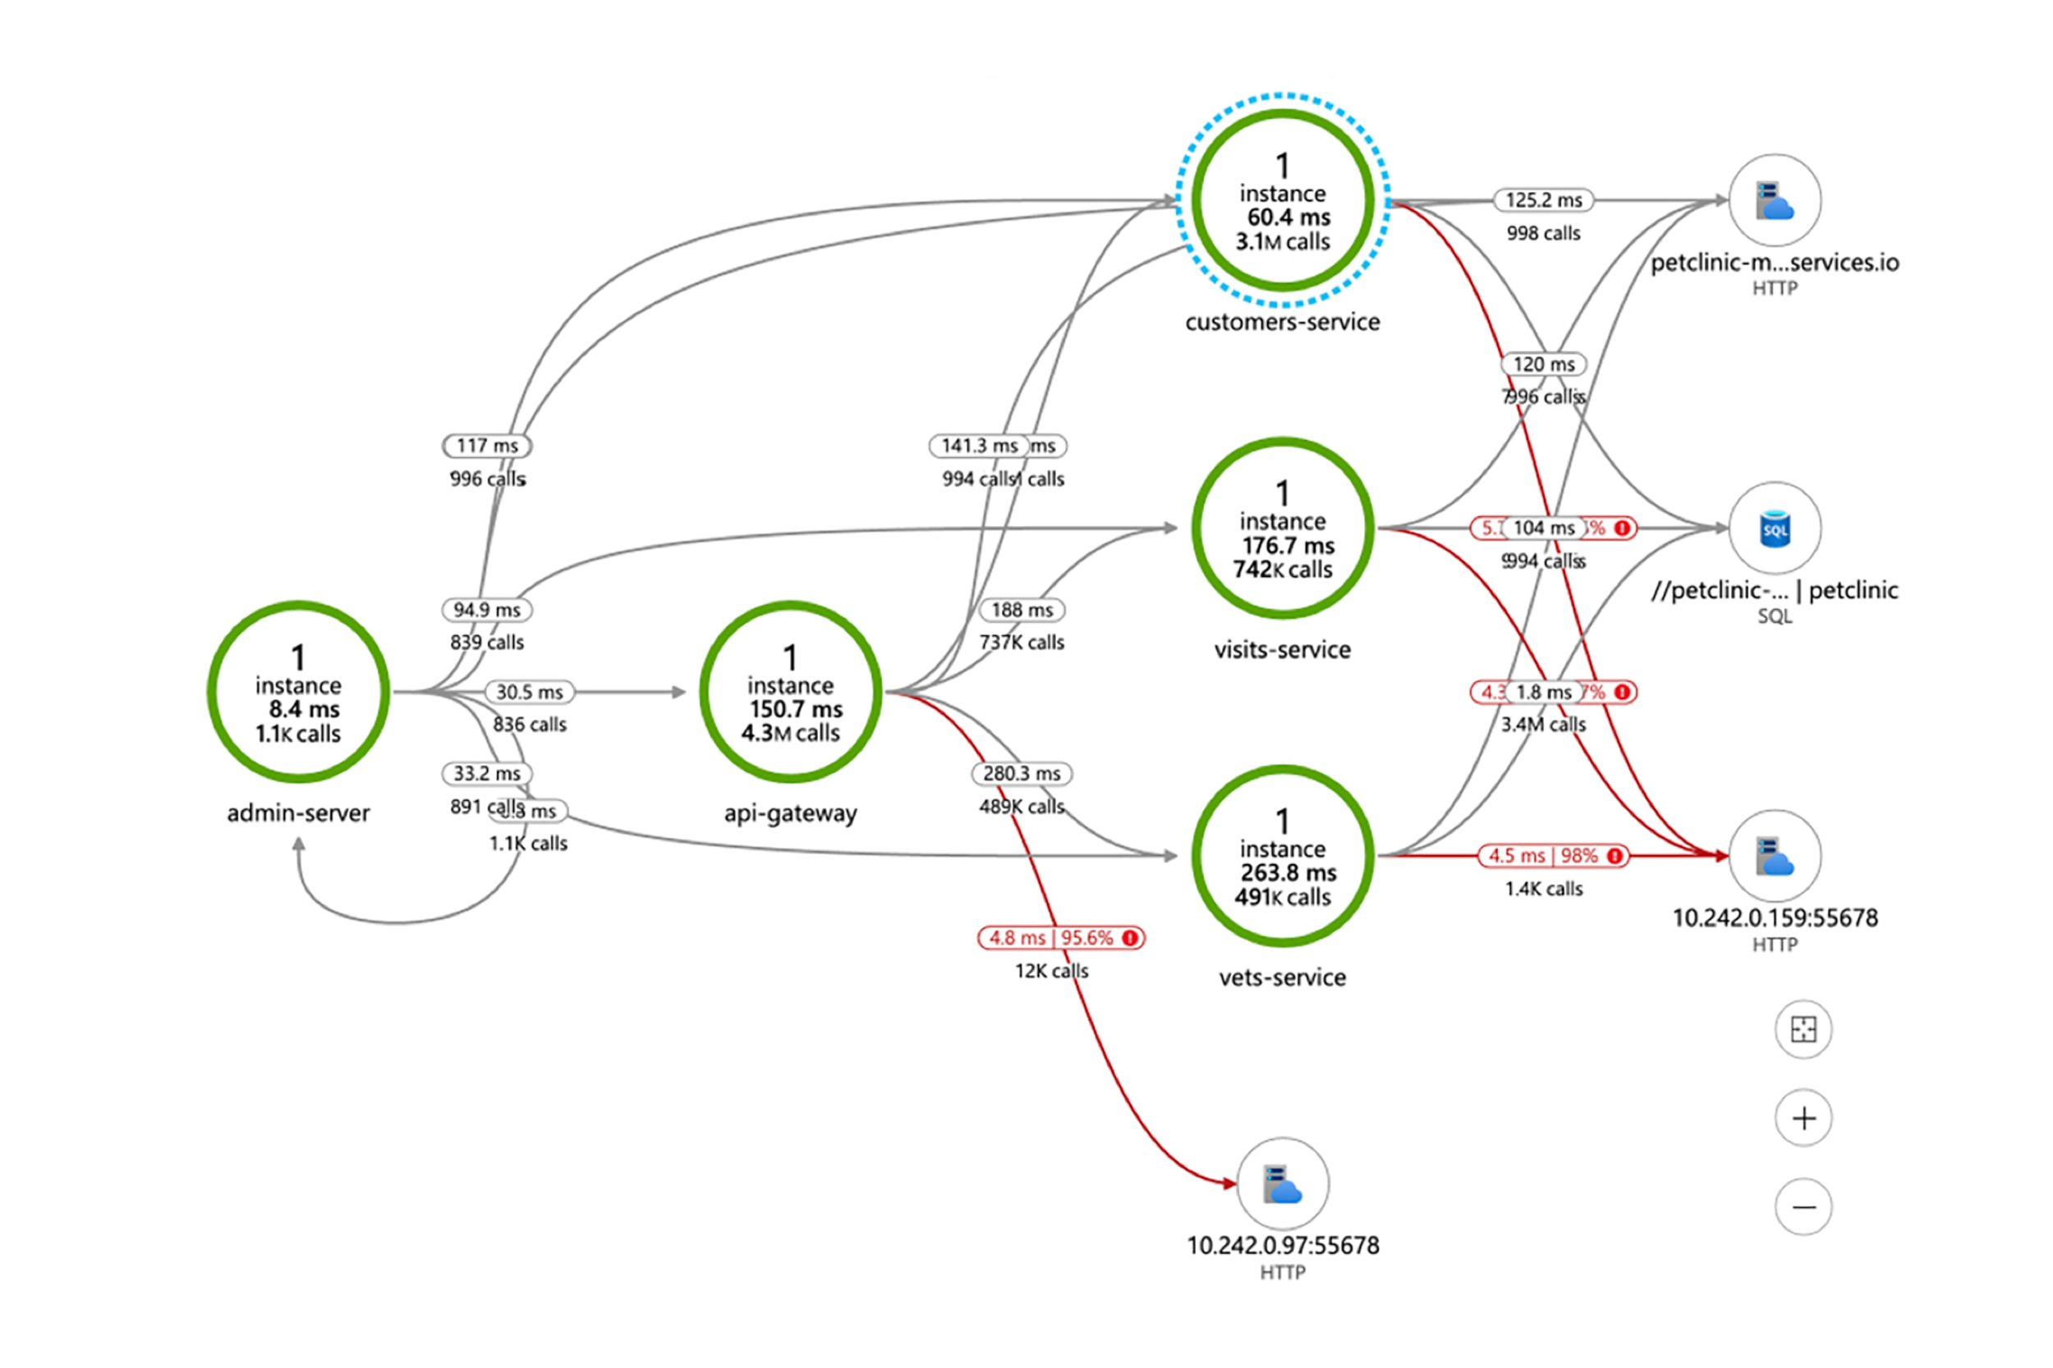
Monitor end-to-end using any tool and platform
Notes:
You can Monitor end-to-end using any tool and platform of your choice!
App Insights, Log Analytics, New Relic, Dynatrace, App Dynamics, Grafana, Elastic or Splunk (14 seconds)

Slide 25

Typical application architecture
Runtime
Frontend User Interface
API Gateway
Backend APIs
Automation
Monitoring
Identity Provider
Databases for Business State
Secrets Management
Notes:
To demonstrate the capabilities of Azure Spring Apps Enterprise lets consider a typical application with a frontend user interface and one one more backend APIs, such as application will need:
API gateway to route traffic to the correct components of the applications, and to enforce cross cutting concerns such as api endpoints require the user to be logged in
Identity provider that can be used to login users into the application
One or more databases for each of the backend apis that are part of the application
Comply with Information security policies that all sensitive configurations such as passwords, api keys, be stored in a secure secrets management solution
We also a way to implement continues delivery for the application and its components so we will need great solutions for
Automating for deploying the application
Monitoring to support troubleshooting, planning capacities, keeping an eye on production
Runtime that can autoscale application components based on demand

Slide 26


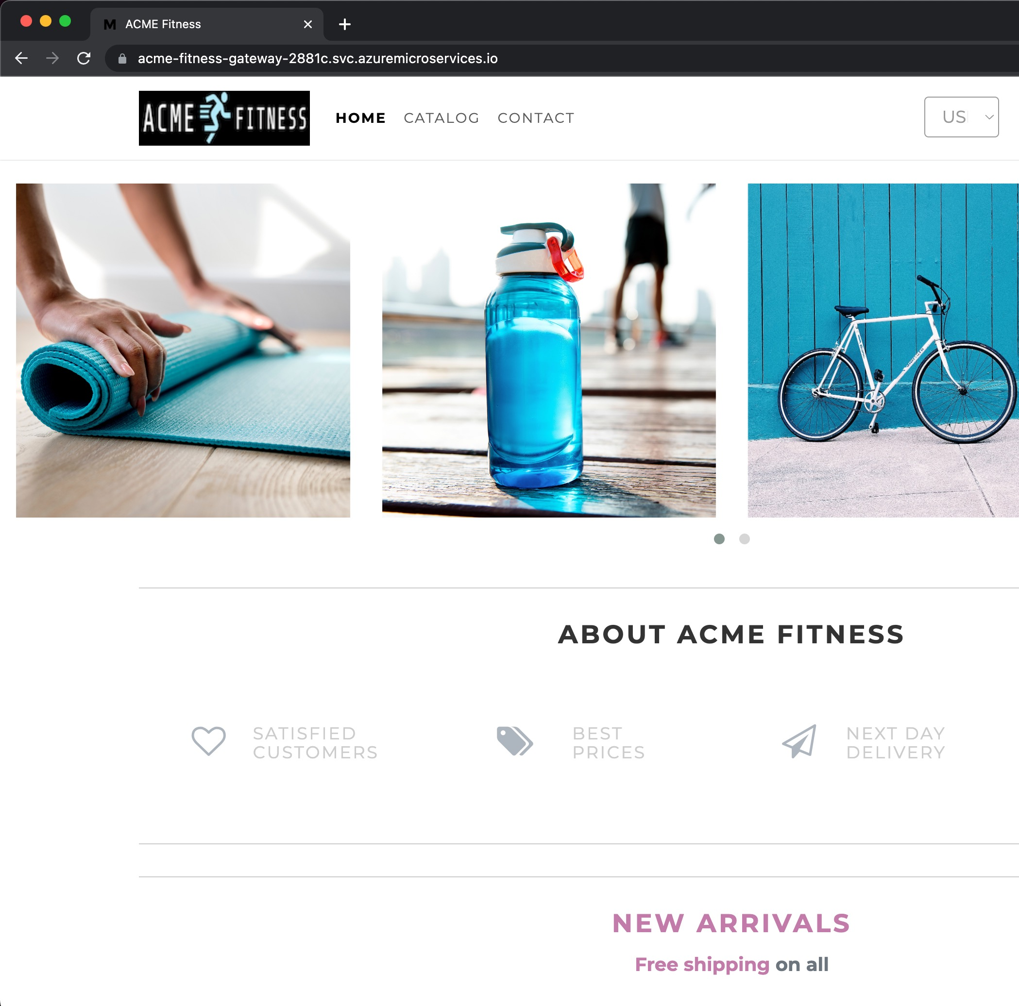
Acme Fitness
aka.ms/fitness-store
Notes:
We will now go through a demo of the functionality of the ACME store application that implement typical architecture we just discussed so that we can zoom in on each of the capabilities of Azure Spring Apps Enterprise
[Place demo video 00:00 to 01:17 after this slide]

Slide 27
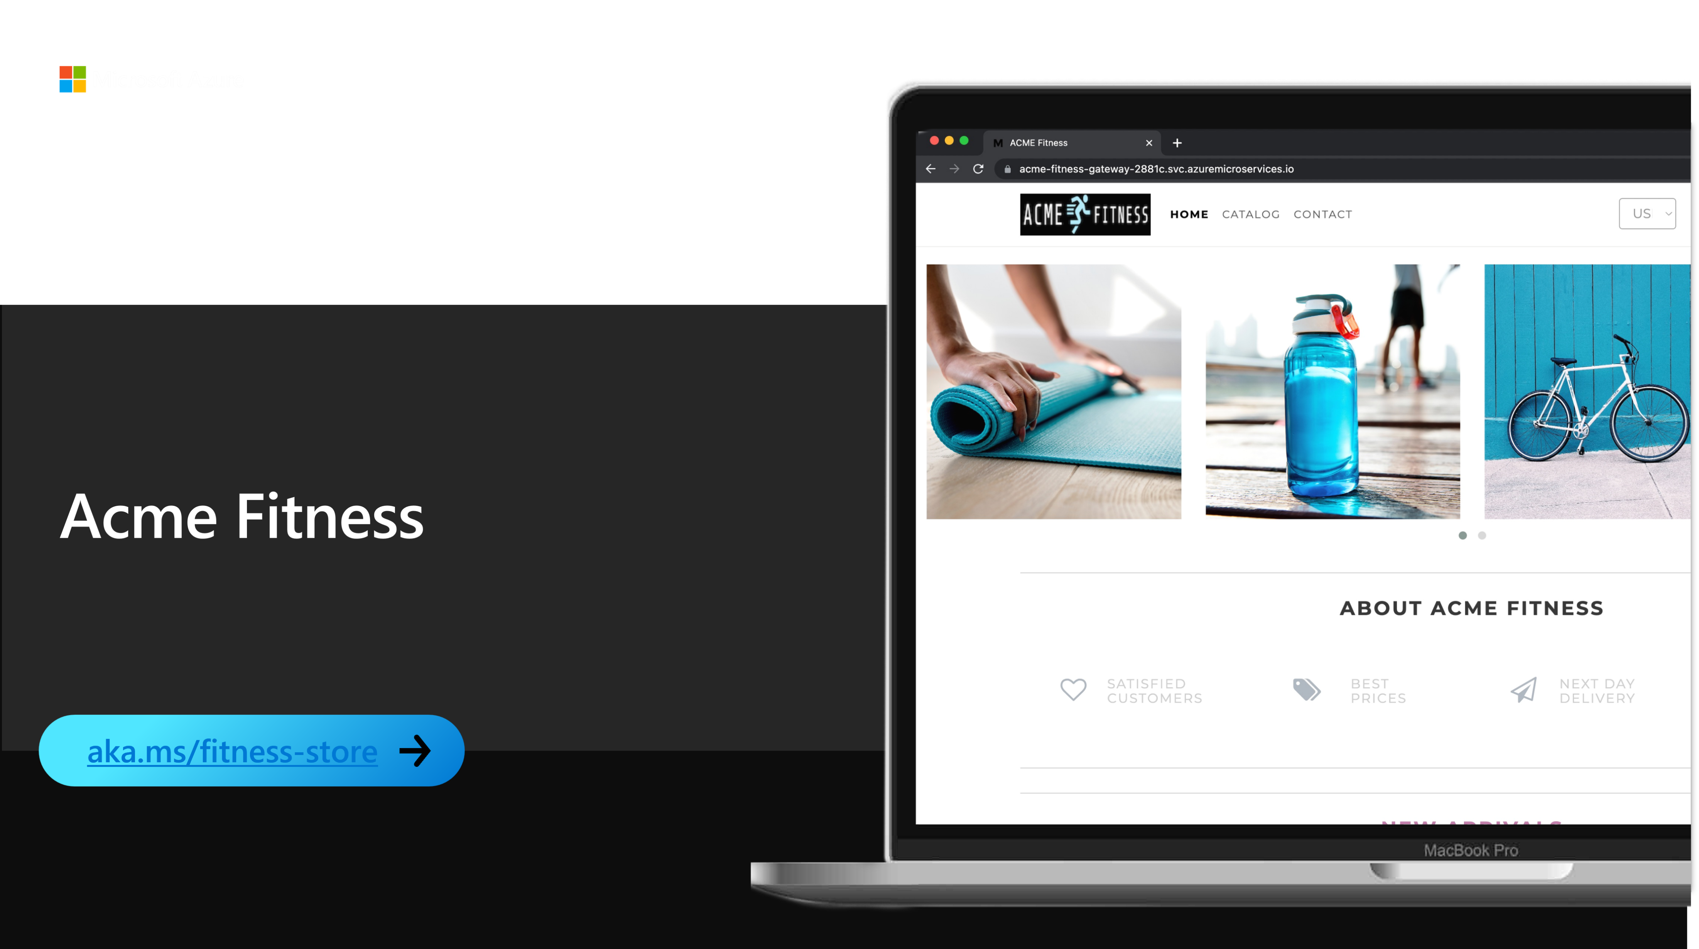
Acme fitness demo

Slide 28


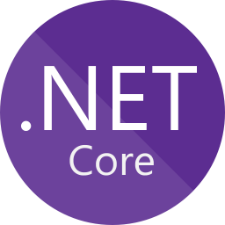


Common app architecture
Azure Spring Apps
Frontend: NodeJS
Spring Apps Gateway
Backend APIs
Identity Catalog Payment
Cart
Order
Automation
Monitoring
Azure Active
Directory
PostgreSQL
Redis
Key Vault
Notes:
ACME fitness is a polyglot application it has components written in
Primarily is Java Spring Boot API
Secondary services in Python and C#
Java Script and HTML5 UI
Spring Apps Gateway with commercial filter is used to route traffic and secure the end points of the applications
Azure active directory is used as the identity provider to manage logins into the application
PostgreSQL is used as the backend database for the various APIs
Azure key vault is used to store the application secrets
Azure Spring Apps enterprise is used to easily automate application deployment, motioning and scaling
Lets now see how to create an instance of azure spring apps enterprise and how to deploy apps to it.

